Slide 1
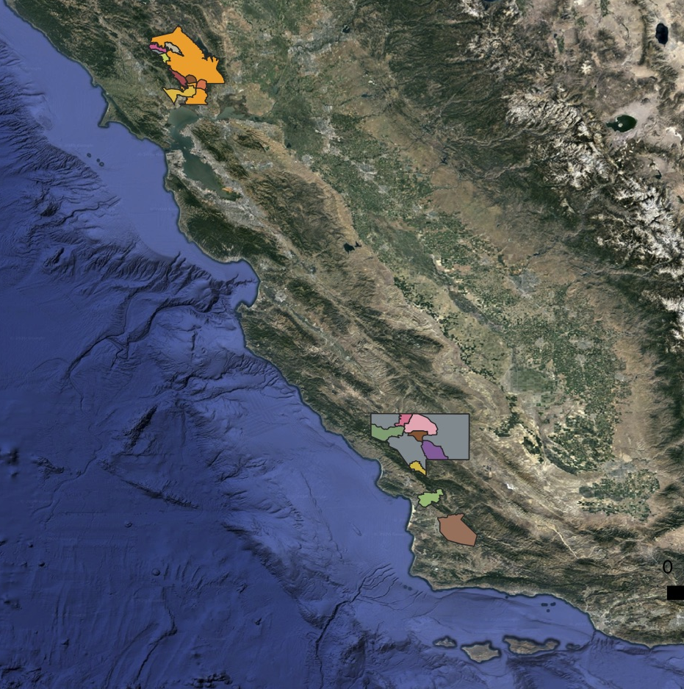
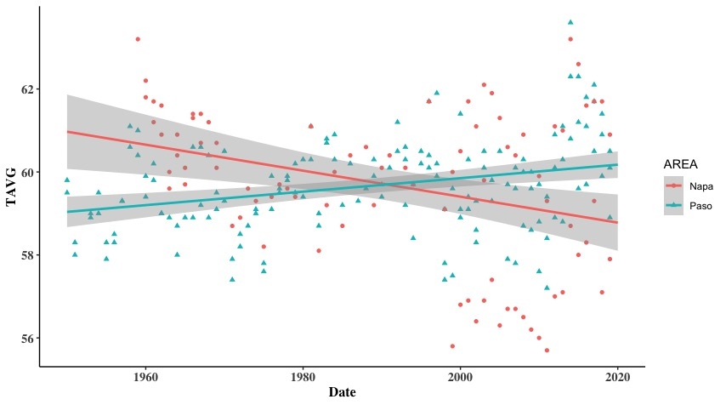
Napa Valley and Paso Robles are the most lucrative wine regions in the US.
Organized by AVAs (American Viticulture Areas) based on grape and regional characteristics.
However, Climate change is threatening these regions
PROBLEM: AVAs crafted in the 1960s lack this info and may not be sustainable.

Slide 2
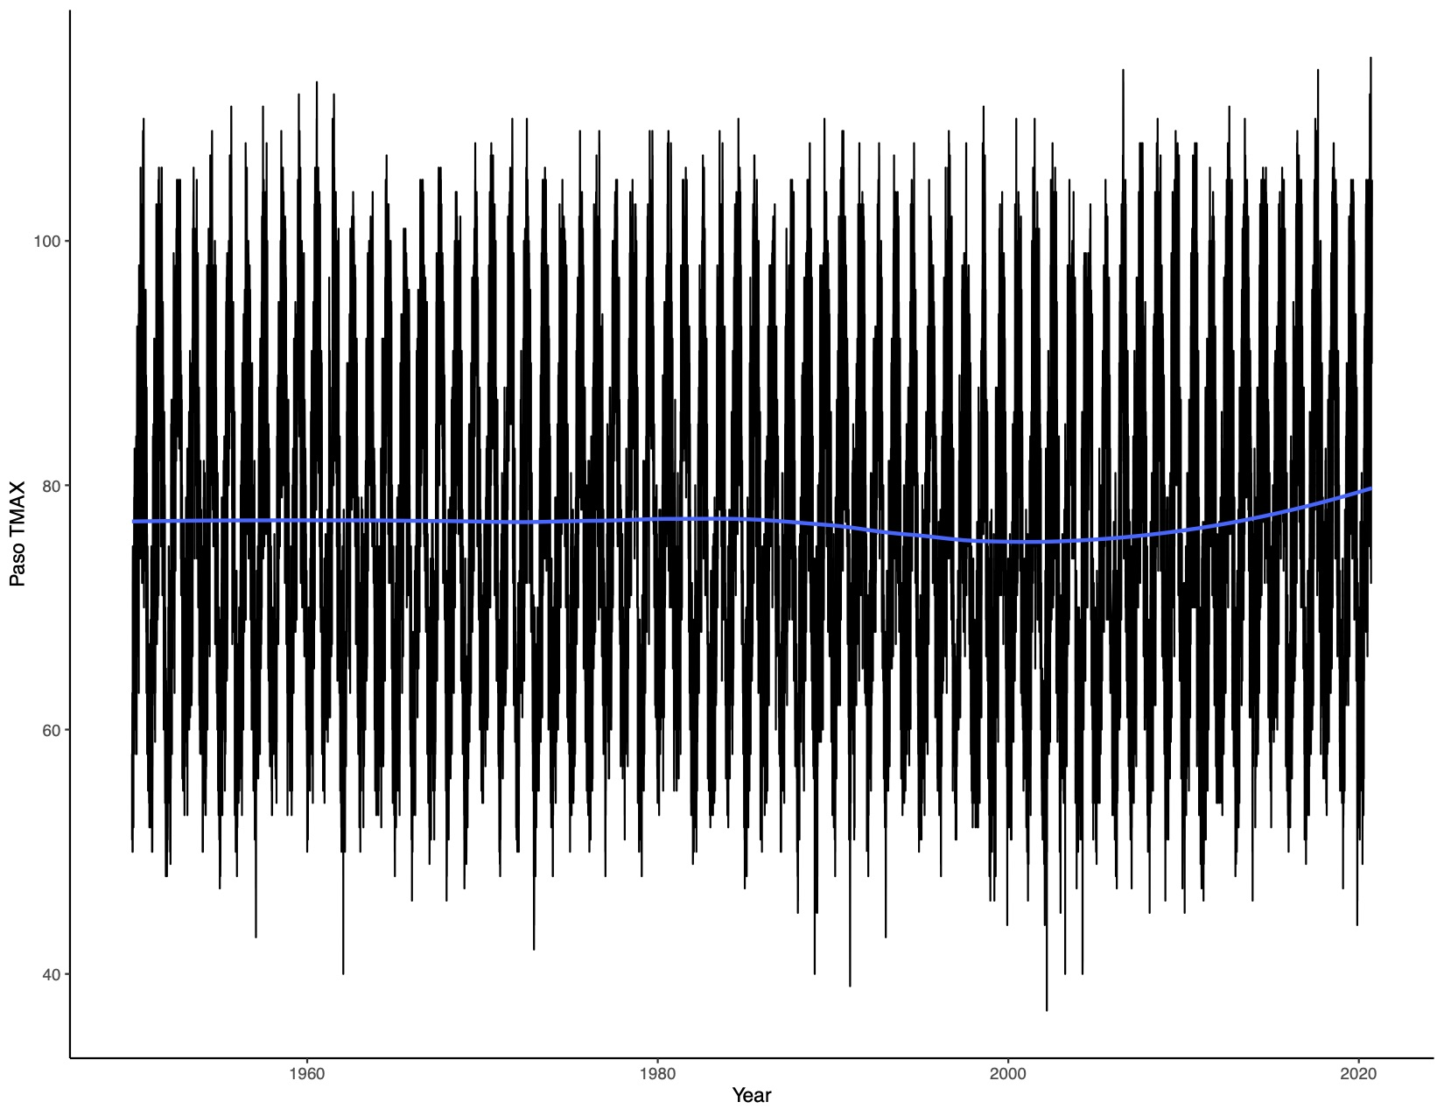
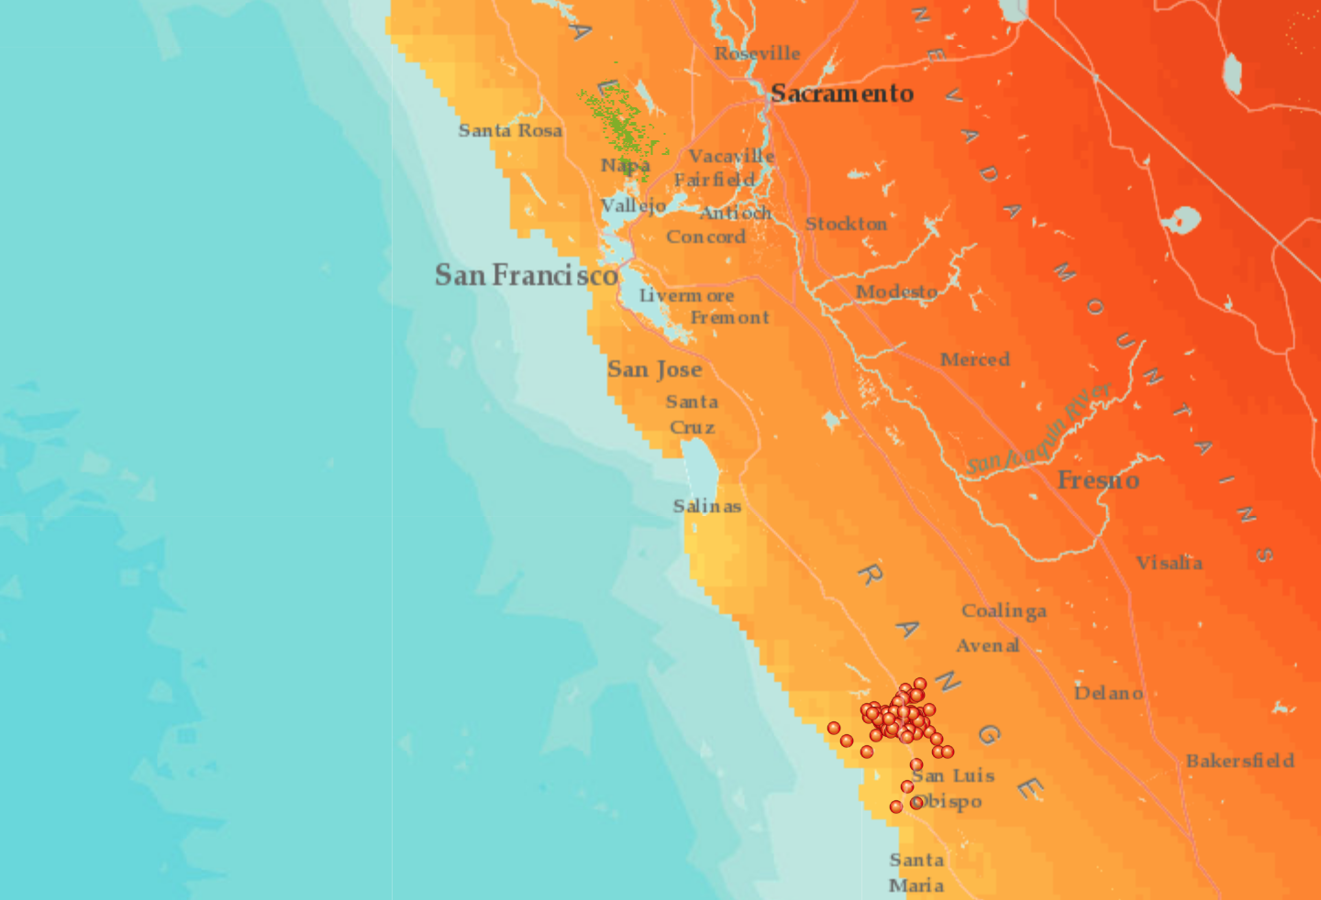
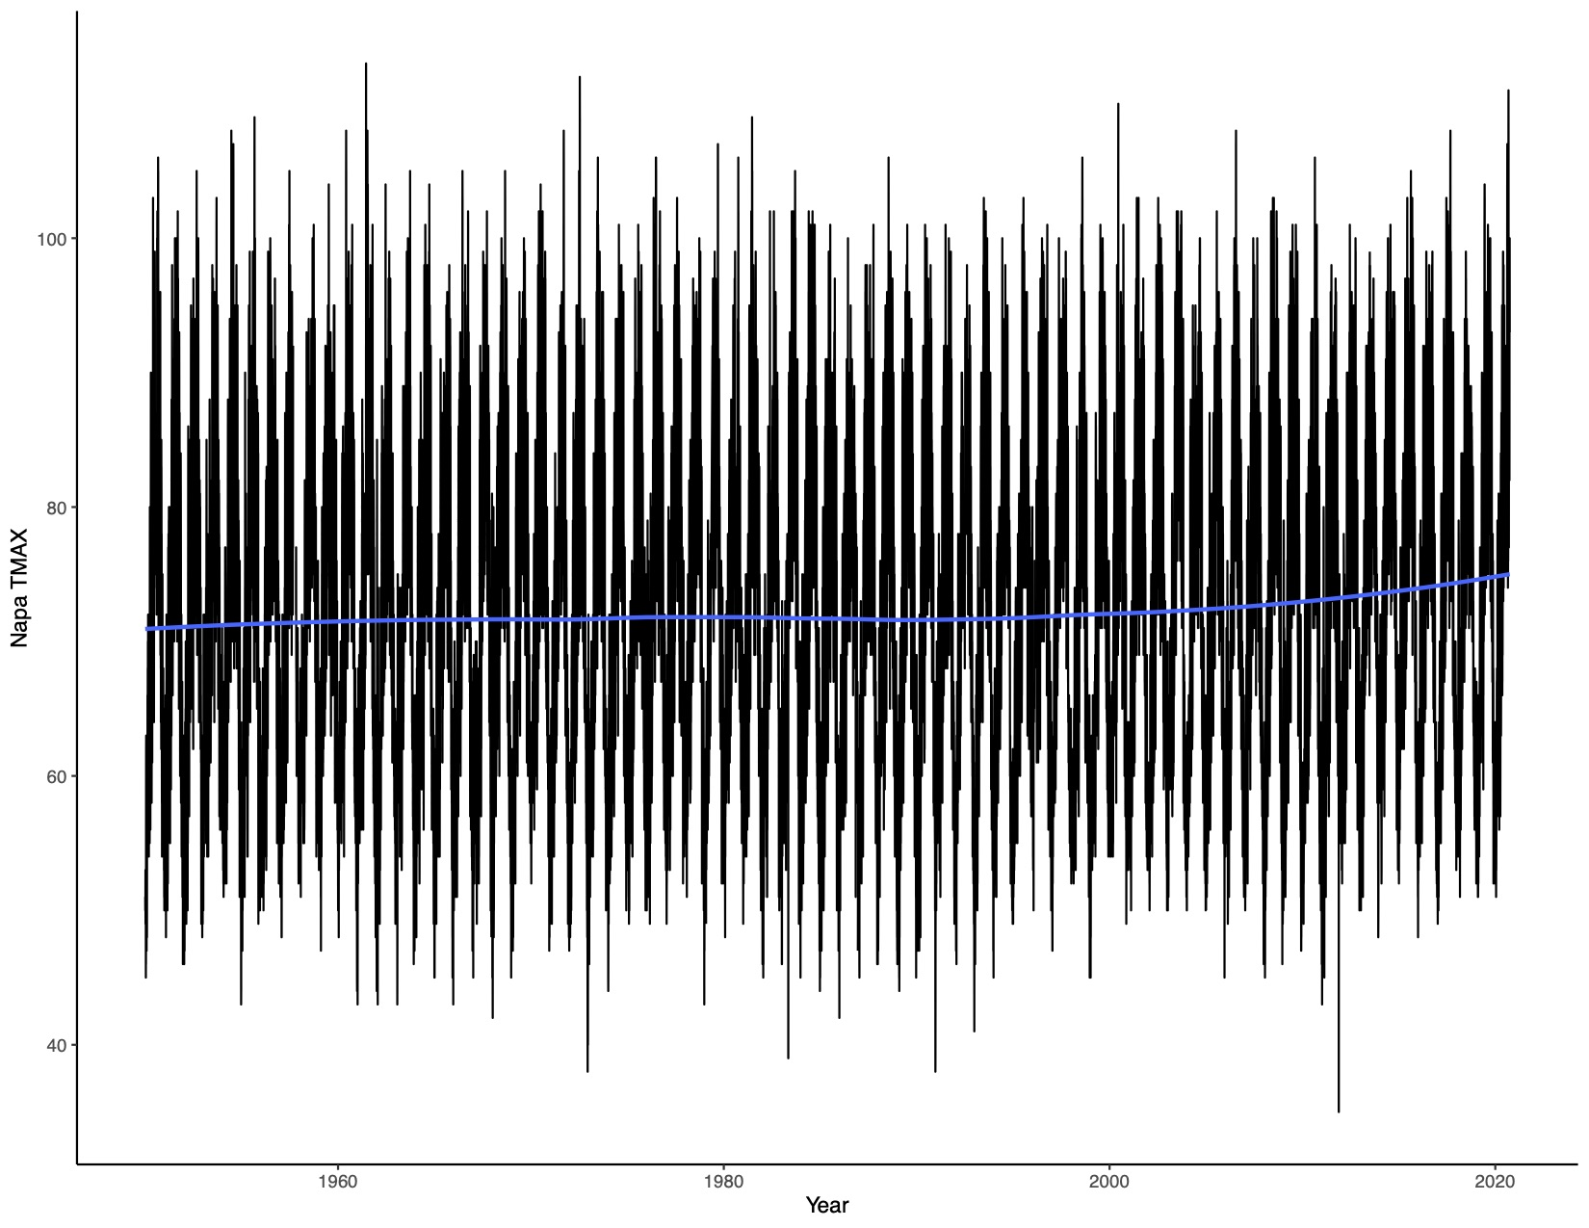
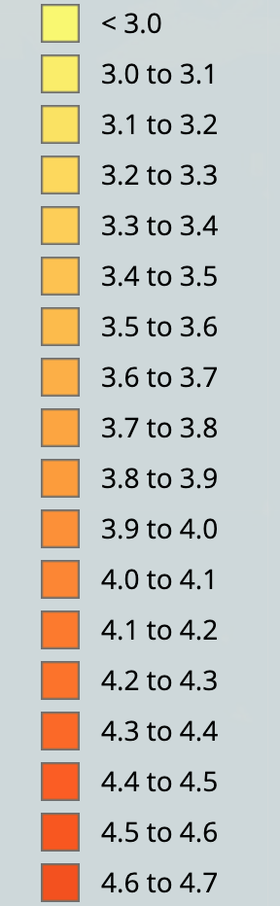
Both Napa Valley and Paso Robles have projected increasing temperature in 2050
SUPPORTING DATA

Slide 3
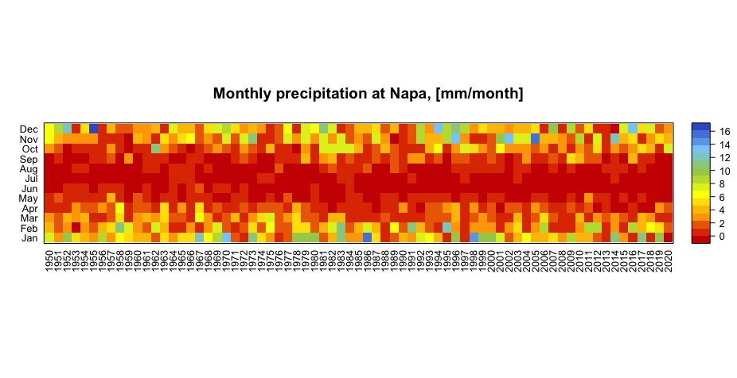
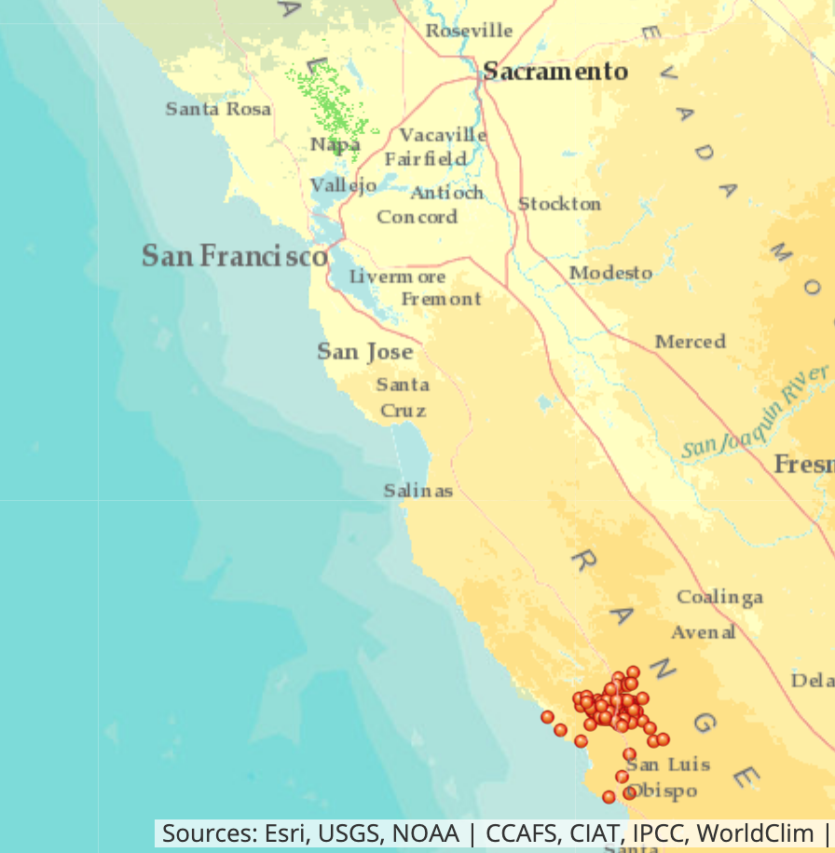
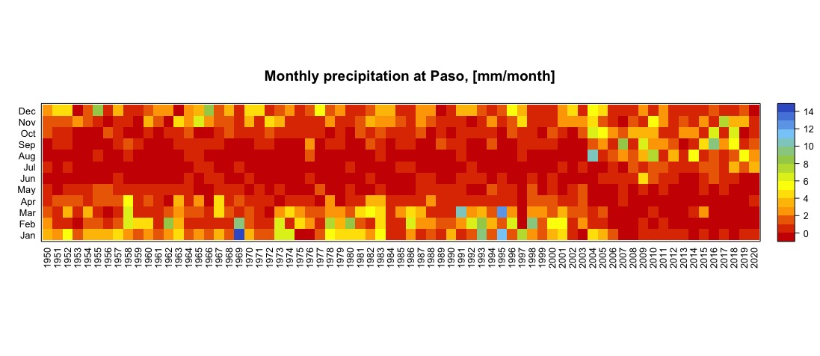
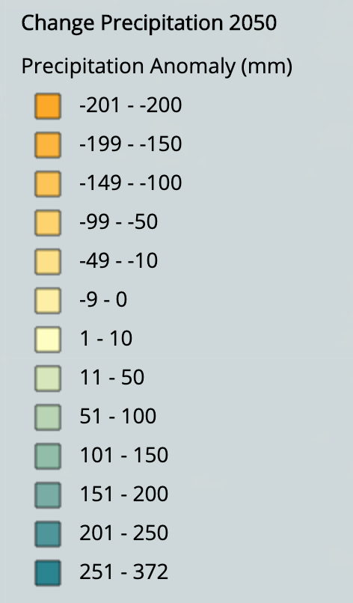
Napa Valley has increasing precipitation (+1-10 mm). Paso Robles has decreasing precipitation (-50-100 mm) But both have seasonal changes as well.
SUPPORTING DATA

Slide 4
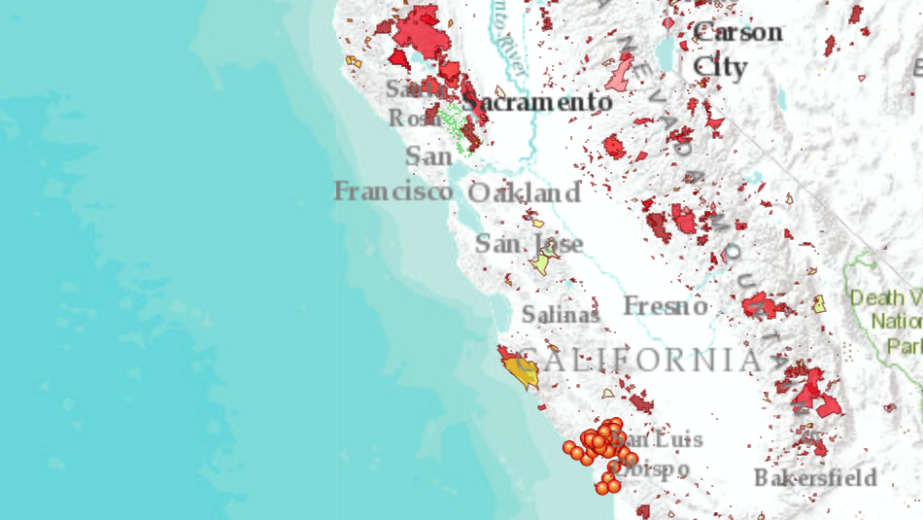
SUPPORTING DATA
Napa Valley has significantly higher fire risk, with increased proximity to historical fires and old redwood forests, resulting in increased historical fire perimeters.
Paso Robles has had far fewer fires in the past 20 years, even though they have less precipitation and higher temps.

Slide 5
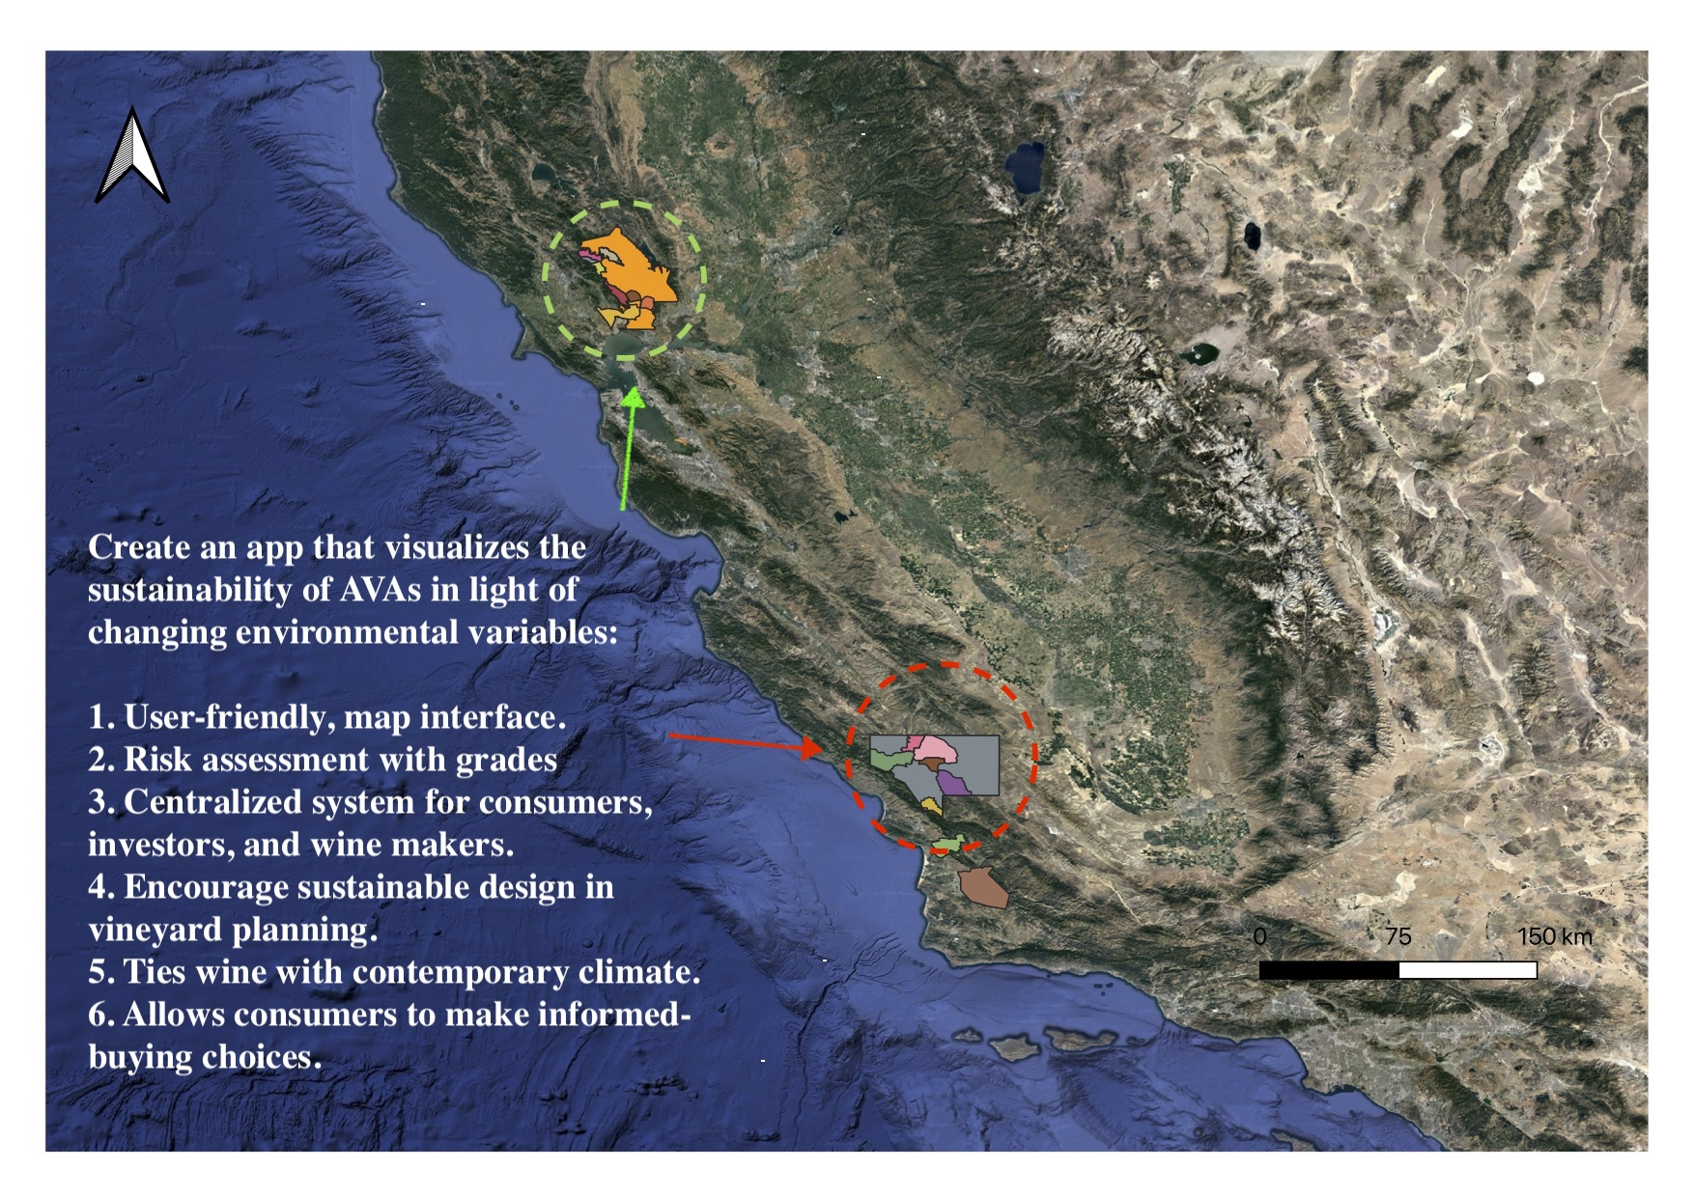
Code regions from green to red based on the degree of risk of crop failure and yield loss within their AVAs. Sustainable AVAs Take trends from 1950-1975 as baseline to assess today's AVAs and develop risk coding system.
SOLUTION

